Slide 1
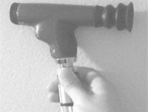
Stanford Medicine 25 Fundoscopy

Slide 2
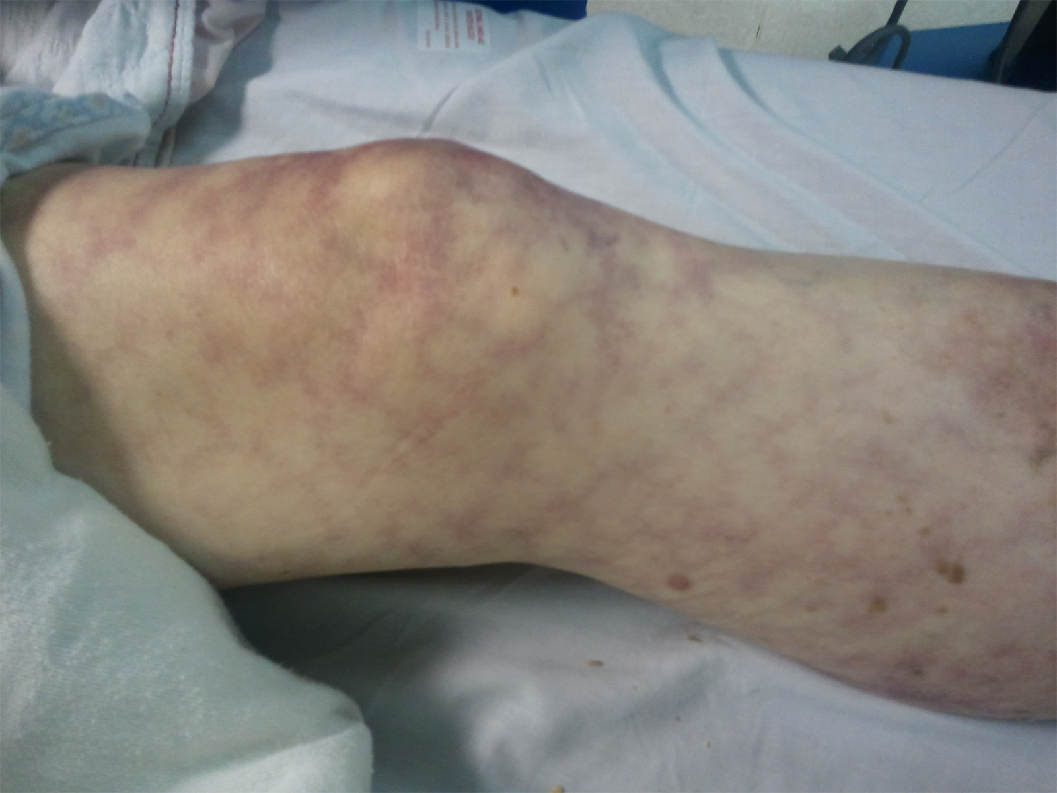

Slide 3
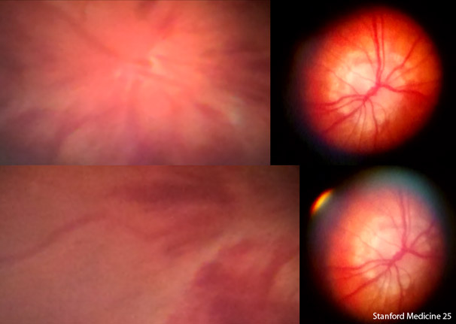

Slide 4
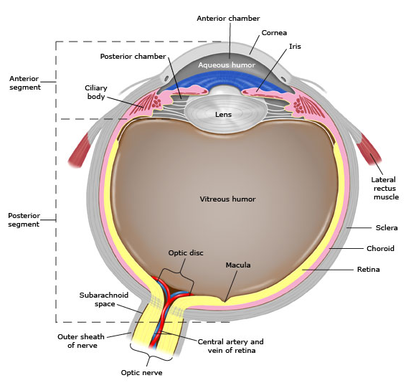
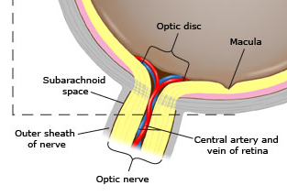

Slide 5
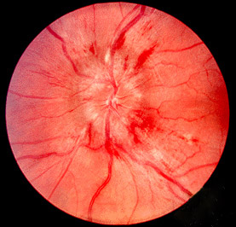
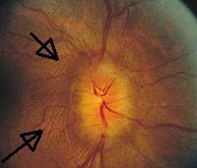
Papilledema
Fundoscopic Findings:
Venous engorgement/hyperemia
Loss of venous pulsations (nrml in 20-30%)
Hemorrhages
Elevation of optic disc
Paton’s lines

Slide 6
Optic disk blurring
Papilledema: Increased intracranial pressure
Occurs hours to days
Causes:
brain tumor
pseudotumor cerebri
sinus thrombosis
hydrocephalus
Meningitis/encephalitis
Malignant HTN
Optic neuritis (1/3 of acute cases)* not from high pressure

Slide 7
IDSA guidelines: CT prior to LP
Immunocompromised state (eg, HIV infection, immunosuppressive therapy, solid organ or hematopoietic stem cell transplantation)
History of CNS disease (mass lesion, stroke, or focal infection)
New onset seizure (within one week of presentation)
Abnormal level of consciousness
Focal neurologic deficit
Papilledema!

Slide 8
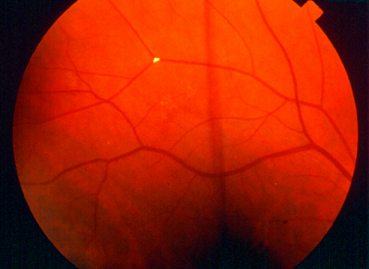

Slide 9
Hollenhorst Plaque

Slide 10
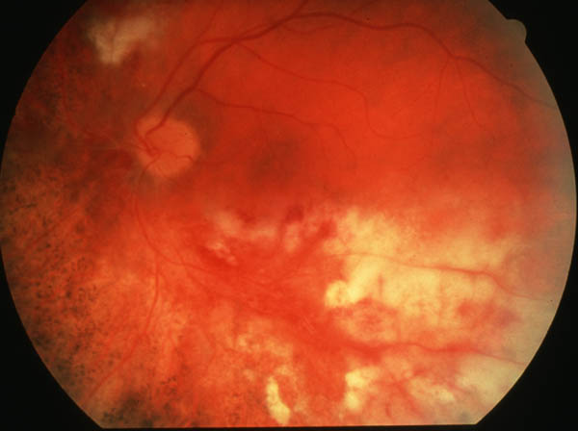

Slide 11
CMV Retinitis

Slide 12
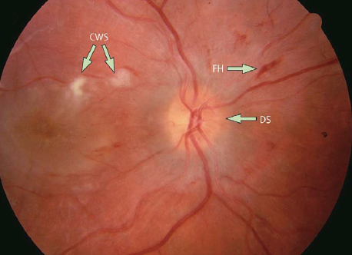

Slide 13
Hypertensive Retinopathy

Slide 14
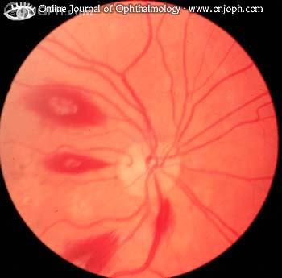
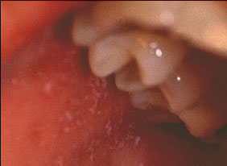

Slide 15
Roth Spots
Koplik’s Spots

Slide 16
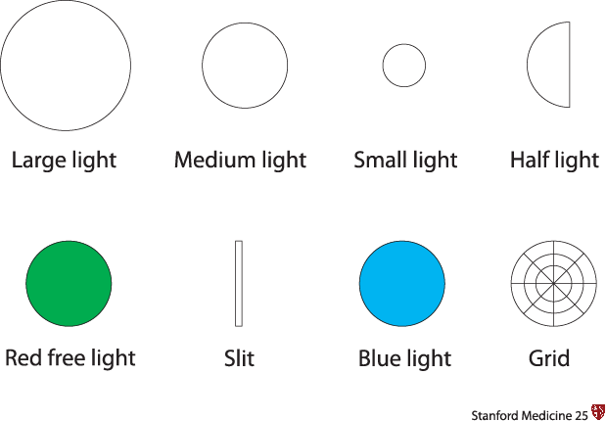

Slide 17
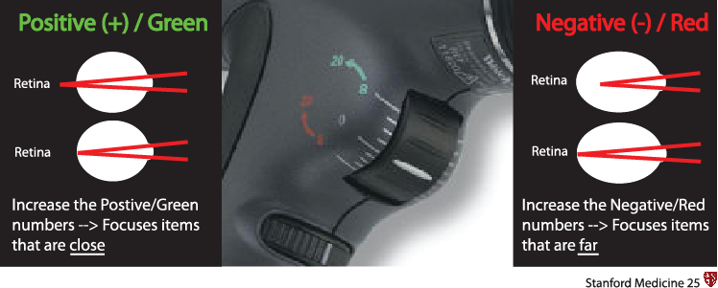

Slide 18
Dilation
Parasympathetic agonists: paralyze circular muscle of iris (mydrasis) and the ciliary muscle (loss of accommodation).
Tropicamide: 1-2 drops (1%) 15-20 minutes before exam; may repeat x1. Individuals with heavily pigmented eyes may require larger doses.
Cyclopentolate:1 drop of 1% followed by another drop in 5 min; 2% solution in heavily pigmented iris.
Atropine: (1% solution): Instill 1-2 drops 1 hour before the procedure.
Homatropine:1 drop of 2% solution immediately before the procedure; repeat at 10 min intervals PRN.
Sympathetic agonists:
Phenylephrine: 1 drop of 2.5% or 10% solution, may repeat in 10-60 min PRN.
Results The risk of inducing acute glaucoma following mydriasis with tropicamide alone is close to zero, no case being identified. The risk with long-acting or combined agents is between 1 in 3380 and 1 in 20 000. The presence of chronic glaucoma constitutes no additional risk. Conclusions Mydriasis with tropicamide alone is safe even in people with chronic glaucoma. It should be advised in all patients when thorough retinal examination is indicated.

Slide 19
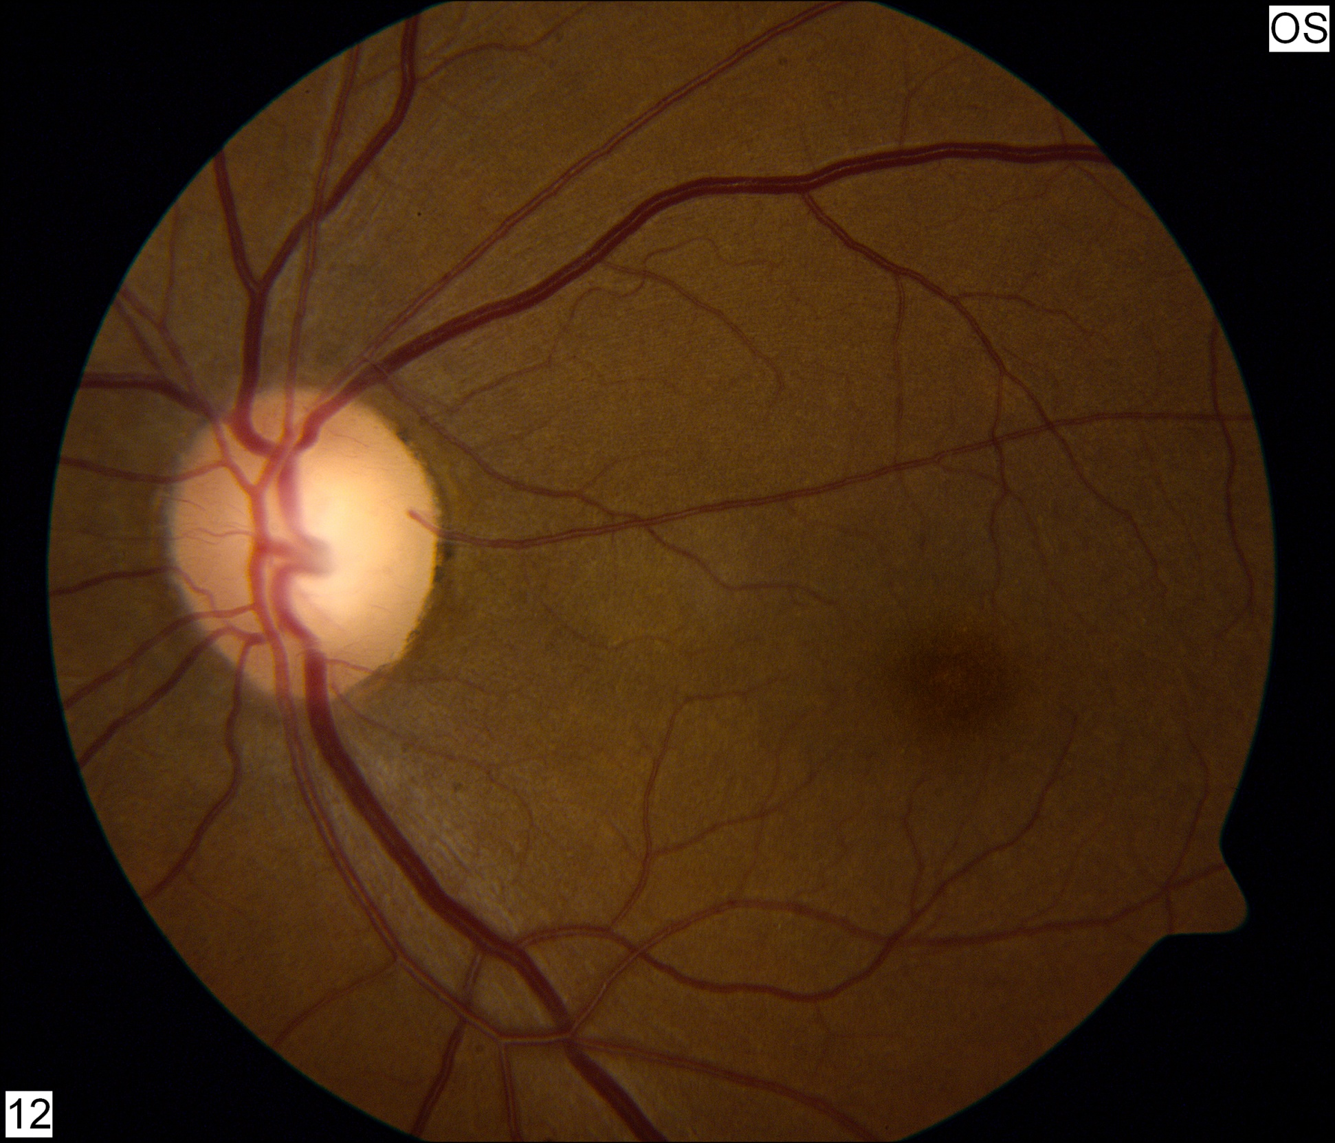
The Fundus
Superior arcade
Macula
Optic cup
Fovea
Optic disc
Inferior arcade

Slide 20
Spontaneous Venous Pulsations
Normally absent in 20-30% of people
If present, essentially rules out increased intracranial pressure

Slide 21
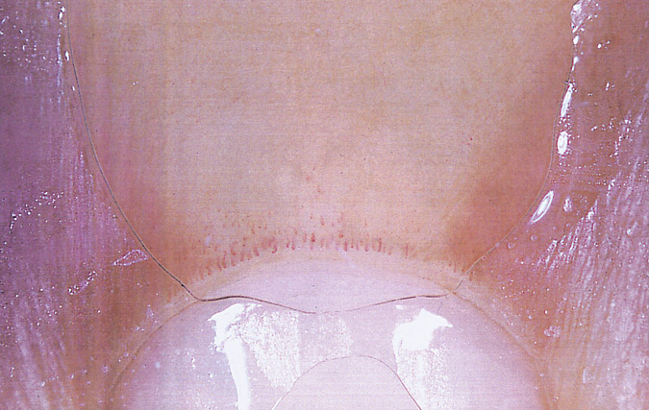
Normal nail-fold capillary pattern consisting of even distribution of thin hairpinlike capillary loops. Note the compression of the oil film with the dermatoscopic front plate.

Slide 22
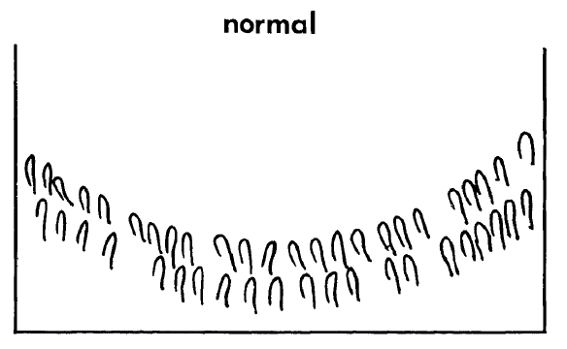
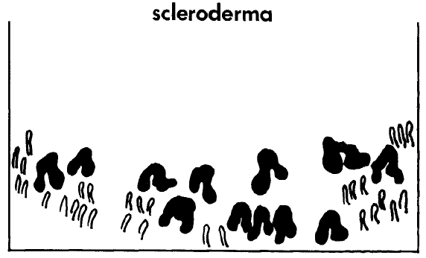

Slide 23
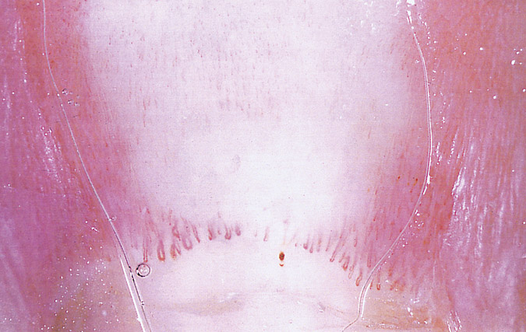
An abnormal nail-fold capillary pattern constituting a scleroderma-dermatomyositis pattern. There are enlarged capillary loops and a single extravasate.

Slide 24
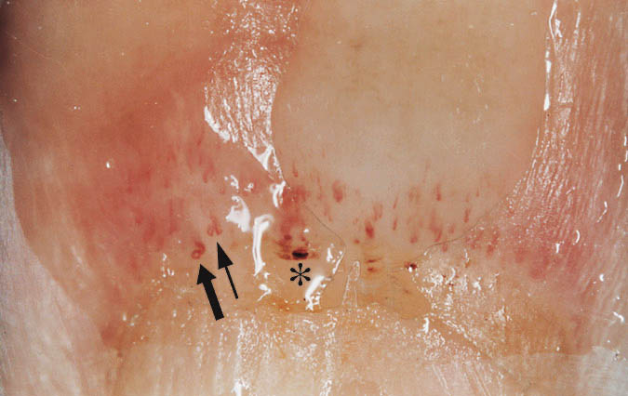
An abnormal nail-fold capillary pattern constituting a scleroderma-dermatomyositis pattern. The capillary distribution is distorted and irregular. There are enlarged capillaries, including "budding" capillaries (thin arrow), twisted capillaries (thick arrow), and extravasates (asterisk).

Slide 26
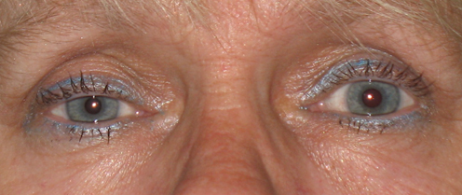

Slide 28
Relative Afferent Pupillary Defect (RAPD, Marcus Gunn Pupil)
Some causes of a RAPD include:
optic neuritis
ischemic optic disease or retinal disease
severe glaucoma causing trauma to optic nerve
direct optic nerve damage (trauma, radiation, tumor)
retinal detachment
very severe macular degeneration
retinal infection (CMV, herpes)

